Slide 1
Facultad de Ciencias Médicas De Sagua La Grande
Asignaturas : Inglès IX y X
Carrera: Medicina
Año: 5to
Rotación: Ortopedia

Slide 2
Profesora asistente: Jessie Sarduy Santana
Profesora auxiliar: Elizabeth Finalet Marreos

Slide 3
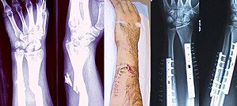
Bone Fracture

Slide 4
Objectives:
To describe the main features of Bones fractures

Slide 5
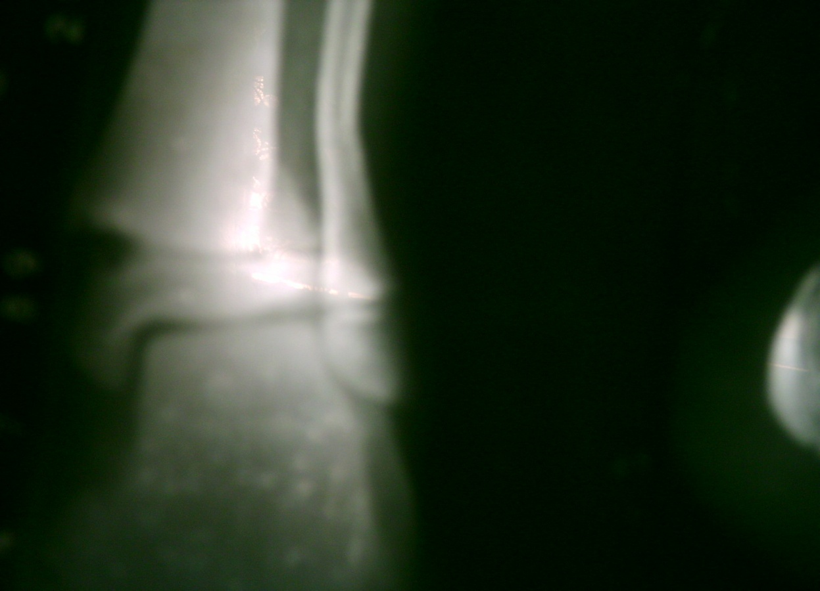
Definition
A bone fracture is a medical condition in which there is a partial or complete break in the continuity of the bone.
Notes:
Alcides

Slide 6
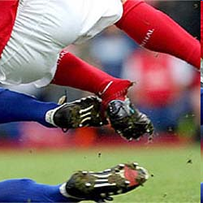
Causes
Traumas
Stress
Osteoporosis
Osteopenia
Bone Cancer
Osteogenesis Imperfecta
Notes:
A bone fracture may be the result of high force impact or stress, or a minimal trauma injury as a result of certain medical conditions that weaken the bones, such as osteoporosis, osteopenia, bone cancer, or osteogenesis imperfecta, where the fracture is then properly termed a pathologic fracture.
ALCIDES

Slide 7
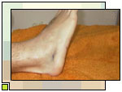
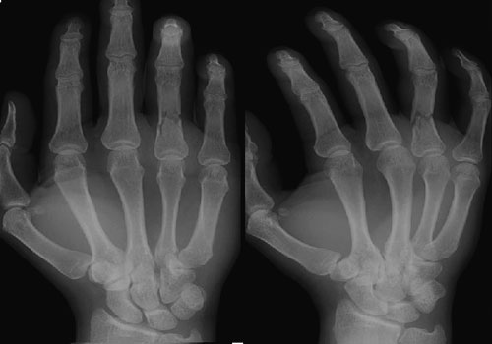
Signs and Symptoms
Pain
Edema of nearby soft tissues
Severe Funcional Impairment
Involuntary muscle spasms trying to hold bone fragments in place.
Hematoma on the fracture site.
Damage to adjacent structures such as nerves, muscles or blood vessels
Notes:
ALCIDES

Slide 8
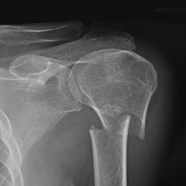
Classification
In orthopedic medicine, fractures are classified in various ways
Notes:
YORDAN

Slide 9
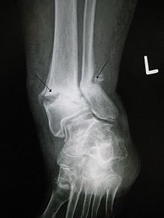
Mechanism
Traumatic fracture
Pathologic fracture
Periprosthetic fracture
Notes:
Mechanism[edit]
Traumatic fracture – This is a fracture due to sustained trauma. e.g., fractures caused by a fall, road traffic accident, fight, etc.
Pathologic fracture – A fracture through a bone that has been made weak by some underlying disease is called pathological fracture. e.g., a fracture through a bone weakened by metastasis. Osteoporosis is the most common cause of pathological fracture.
Periprosthetic fracture – This is a fracture at the point of mechanical weakness at the end of an implant
YORDAN

Slide 10
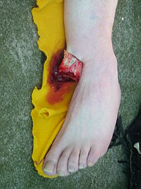
Soft-tissue involvement
Closed fractures
Open/compound fractures:
Clean fracture
Contaminated fracture
Notes:
Soft-tissue involvement[edit]
Closed fractures are those in which the overlying skin is intact
Open/compound fractures involve wounds that communicate with the fracture, or where fracture hematoma is exposed, and may thus expose bone to contamination. Open injuries carry a higher risk of infection.
Clean fracture
Contaminated fracture
YORDAN

Slide 11
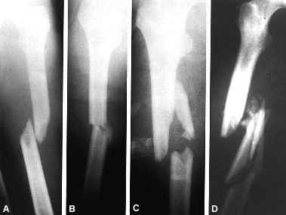
Displacement
Non-displaced
Displaced
Translated, or ad latus, with sideways displacement
Angulated
Rotated
Shortened
Notes:
YORDAN

Slide 12
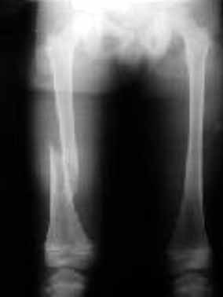
Fracture pattern
Linear fracture
Transverse fracture
Oblique fracture
Spiral fracture
Compression fracture/wedge fracture
Impacted fracture
Avulsion fracture
Notes:
Fracture pattern[edit]
Linear fracture: A fracture that is parallel to the bone's long axis
Transverse fracture: A fracture that is at a right angle to the bone's long axis
Oblique fracture: A fracture that is diagonal to a bone's long axis (more than 30°)
Spiral fracture: A fracture where at least one part of the bone has been twisted
Compression fracture/wedge fracture: usually occurs in the vertebrae, for example when the front portion of a vertebra in the spine collapses due to osteoporosis (a medical condition which causes bones to become brittle and susceptible to fracture, with or without trauma)
Impacted fracture: A fracture caused when bone fragments are driven into each other
Avulsion fracture: A fracture where a fragment of bone is separated from the main mass
YORDAN

Slide 13

Fragments
Incomplete fracture
Complete fracture
Comminuted fracture
Notes:
Incomplete fracture: Is a fracture in which the bone fragments are still partially joined, in such cases, there is a crack in the osseous tissue that does not completely traverse the width of the bone.
Complete fracture: Is a fracture in which bone fragments separate completely.
Comminuted fracture: Is a fracture in which the bone has broken into several pieces
HECTOR

Slide 14
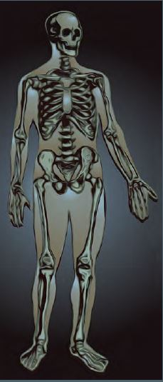
Anatomical location
Skull fracture
Spinal fracture
Rib fracture
Sternal fracture
Shoulder fracture
Notes:
An anatomical classification may begin with specifying the involved body part, such as the head or arm, followed with more specific localization.
ARMANDO

Slide 15
Anatomical location
Arm fracture
Hand fracture
Pelvic fracture
Legs fracture
Foot fracture
Notes:
ARMANDO

Slide 16
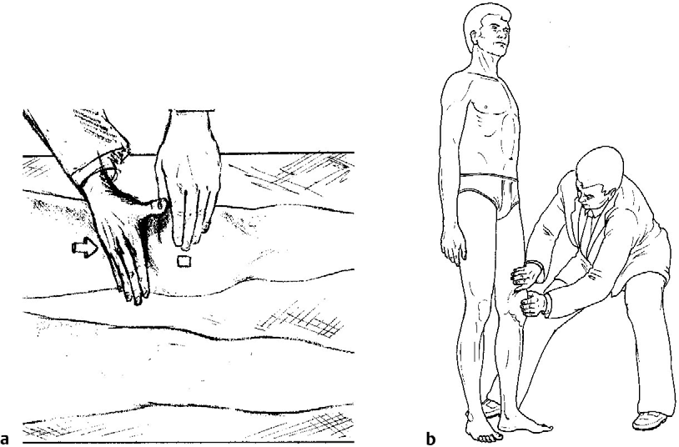
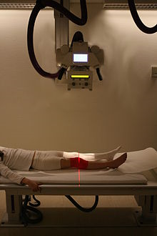
Diagnosis
Physical Examination
Radiographic Imaging
In situations where projectional radiography alone is insufficient, Computed Tomography (CT) or Magnetic Resonance Imaging (MRI) may be indicated
Notes:
A bone fracture may be diagnosed based on the history given and the physical examination performed. Radiographic imaging often is performed to confirm the diagnosis. Under certain circumstances, radiographic examination of the nearby joints is indicated in order to exclude dislocations and fracture-dislocations. In situations where projectional radiography alone is insufficient, Computed Tomography (CT) or Magnetic Resonance Imaging (MRI) may be indicated
HECTOR

Slide 17
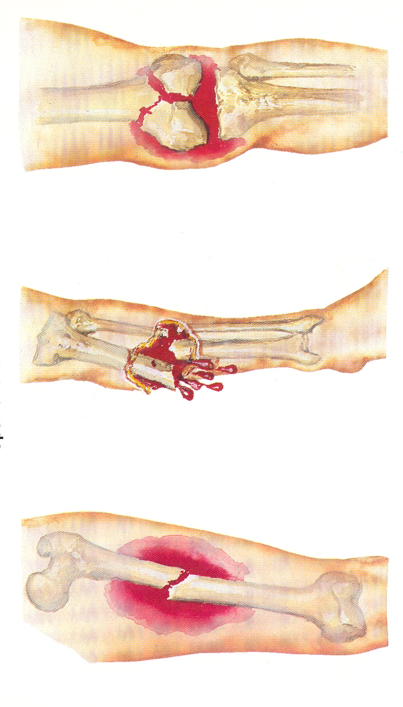
Complications
Immediate complications
Systemic
Hypovolaemic shock
Local
Injury to major vessels
Injury to muscles and tendons
Injury to joints
Injury to viscera
Notes:
complications of fractures may be classified into three broad groups, depending upon their time of occurrence. These are as follows –
Immediate complications – occurs at the time of the fracture.
Early complications – occurring in the initial few days after the fracture.
Late complications – occurring a long time after the fracture.
LILI

Slide 18
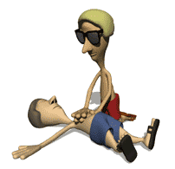
Early complications
Systemic
Hypovolaemic shock
ARDS – Adult respiratory distress syndrome
Fat embolism syndrome
Deep vein thrombosis
Pulmonary syndrome
Aseptic traumatic fever
Local
Infection
Compartment syndrome
Notes:
LILI

Slide 19
Late complications
Imperfect union of the fracture
Delayed union
Non union
Mal union
Cross union
Notes:
YUDY

Slide 20
Others
Avascular necrosis
Shortening
Joint stiffness
Sudeck's dystrophy
Osteomyelitis
Ischaemic contracture
Myositis ossificans
Osteoarthritis
Notes:
YUDY

Slide 21
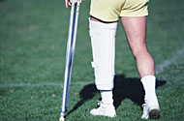
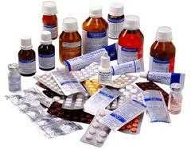
Treatment
Treatment of bone fractures are broadly classified as surgical or conservative
Conservative Treatment
Repose
Analgesics
Anti-inflammatory medications
Immobilization
Notes:
CARLOS

Slide 22
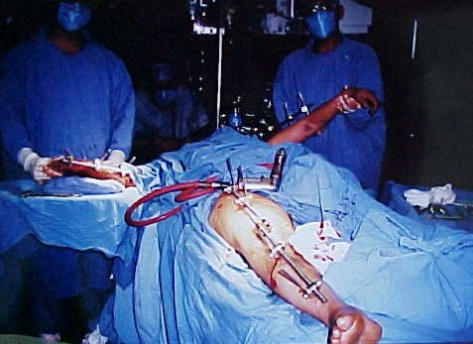
Surgical Treatment
Usually surgery is performed only if conservative treatment has failed, is very likely to fail, or likely to result in a poor functional outcome
.
Notes:
CARLOS

Slide 23
Prognosis
The prognosis is Reserved
Typically people get better on weeks or months but complications are very frequent
Notes:
HECTOR

Slide 24
EXERCISES:
You have been selected to give a health talk to the senior population of your community. You
may wish to have some written notes as a guide.
Work in groups to write an essay in which you may include some of the following issues, e.g.
• What a fracture is
• Risk for fractures
• Forms to avoid them
• Most common fractures
Feel free to add any other relevant aspect.

Slide 25
Bibliografia
English through Medicine II Students and teachers book
Bedside English

