Slide 1
Medical Science Faculty of Sagua la Grande, Villa Clara
Subject: English VII and VIII
Professors
MSc.Julian Cairo Molinet, Assistant professor
BA. Miguel Sánchez Gómez, Assistant professor

Slide 2
SPONTANEOUS ABORTION/MSCARIAGE
Objective:
To describe different features of Spontaneous Abortion in order to prepare students to talk about this medical condition and discuss a case in English

Slide 3
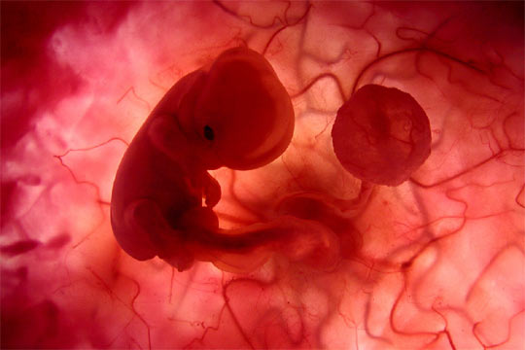
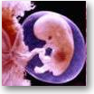
SPONTANEOUS ABORTION
Loss of pregnancy naturally before the fetus can survive

Slide 4
TYPES
Threatened
Complete
Septic
Incomplete
Inevitable
Missed
Recurrent

Slide 5
SYMPTOMS
Vaginal bleeding
Lower abdominal pain
Pelvic cramping pain
Purulent vaginal discharge
Fever

Slide 6
Cromosomal abnormalities
Infectious
High blood pressure
Progesteron deficiency
Diabetes
CAUSES

Slide 7
Risk Factors
Age (35)
History of spontaneous abortion
Cigarette smoking
Use of certain drugs (cocaine,alcohol,high doses of caffeine)
A poorly controlled chronic disorder ( Diabetes, Hypertension)

Slide 8
Treatment
Medical management with misoprostol
Surgical management(Dilation and suction curettage)
Observation for threatened abortion
Emotional support

Slide 9
After studying this condition, write a paragraph answering the following questions.
( See also Useful Phrases Document). Send the text to: juliancm@infomed.sld.cu
What is Spontaneous abortion?
What are the main signs and symptoms?
What is the classification?
Who is at risk of this condition?
How is it diagnosed?
What is the differential diagnosis?
What are the possible complications?
What does the treatment include?
What is the prognosis?

Slide 10
Useful phrases to give information about a medical condition
Concept
… is defined/known as…
.. is…
Classification
-The classification of …..includes….
… is classified into …
……is the classification of ..
-Signs and Symptoms
-The most common signs and symptoms of _____include…..
_____,_____,___and_____ are the most common signs and symptoms
Risk factors
-Risk factors for … include …
-People with … are at a higher risk for developing…
-In patients with a long history of … … is highly probable to suffer …
________, _______, and________ are the main risk factors for developing ______

Slide 11
Diagnostic procedures/Exams and investigation/Lab tests
The main diagnostic procedures/Exams and investigation/Lab tests for HBP are/include: ________,_____-and_________.
HBP can by diagnosed by ___________,_______,and________.
________, _________, ________ and________are the main diagnostic procedures/Exams and investigation/Lab tests for HBP

Slide 12
Differential diagnosis
The possibility of __________should not be excluded.
___________ is a very likely/ highly probable/ diagnosis.
__________ can cause pain of similar severity and radiation, but …
_________ is ruled out in this case because …
The differential diagnoses are/include __________ and __________.
Treatment/ management
The treatment (for this condition) include……
The treatment (for this condition) is based on ……
_____________ is the best treatment for this condition…
The treatment consists on_________

Slide 13
Prognosis
The prognosis is good / poor / guarded / bad / reserved.
The prognosis is good if the patient follows the treatment.
Complication
The complications of HBP are mainly …
The most common complication(s) is/ are…
Other complications associated with HBP include… …
_________,________, and ________ are the most common
complication of HBP
….are well-recognized complications of the first episodes of HBP

Slide 14
Bibliography
1. Abbot, G. The Teaching of English as an International Language: A Practical Guide. La Habana: Editorial Revolucionaria; 1989.
2. Agnes, M. (Editor-in-chief) Webster‟s New World College Dictionary. 4th edition: New York: Macmillan; 1999.
3. Ballinger, Ph. Merrill‟s Atlas of Radiographic Positions and Radiologic Procedures. 8th Edition: Mosby; 1995.
4. Bates, B. Guide to Physical Examination and History Taking. 8th edition New York: Lippincott Williams & Wilkins; 2003.
5._______________. English through Medicine Two. Student´s Book. Editorial Ciencias Médicas; 2007.
6._______________. English through Medicine Two. Teacher´s Book. Editorial Ciencias Médicas; 2007.
7. Colectivo de Autores. English for Professional Nursing Communication. Student‟s Book. La Habana: Editorial Ciencias Médicas; 2004.
8. _______________ English for Professional Nursing Communication. Teacher‟s Book. La Habana: Editorial Ciencias Médicas; 2004.

Slide 15
Thanks!

