Slide 1
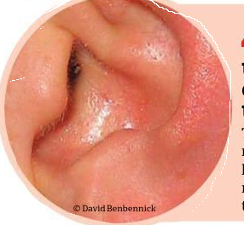
Otitis Media
Professor: Elizabeth Finalet Marrero Jessie Sarduy Santana

Slide 2
Objectives:
To describe Otitis Media
To Characterize patients with Otitis Media

Slide 3
Definition
Inflammation of the middle ear.
It can be more precisely described by its duration , presence or absence of infection, and presence or absence of effusion.

Slide 4
Acute Supurative Otitis Media
A clinically identifiable infection of the middle ear in which the symptoms appear suddenly and resolve within 3 weeks.

Slide 5
Nonsupurative Otitis Media
The middle ear inflamation occurs in the absence of an identifiable infectious etiology

Slide 6
Subacute Otitis Media
The inflamatory process persists for more tan 3 weeks but less tan 3 months.

Slide 7
Chronic Otitis Media
A middle ear discharge that persists more than 3 months

Slide 8
Signs and symptoms
Unilateral otalgia
Fever
Nasal discharge in neonats and small children.
Excessive fussiness.
Irritability
Tugging in the affected ear.

Slide 9
Risk factors
First episode < 18 months of age.
Male Gender.
Previous episode of Otitis Media.
Exposure to second hand somoke.

Slide 10
Bottle feeding.
Atttendance at large day –care center
Sibling history of recurrent Otitis Media.

Slide 11
Diagnosis
Based on the patient‘s signs and symptoms.
Otoscopy

Slide 12
Treatment
Antibiotic Therapy.
Antimicrobial Therapy
Alternative Therapy

Slide 13
Some important aspects related to the ear

Slide 17
Excercises
1-Go to your textbook page 141 and do the following exercises:
Lesson I Task 1 items a and b
B-Task 2 item a b and c
2- Study the Power point and do the exercise 1 item a that appears on page 145

