Slide 1
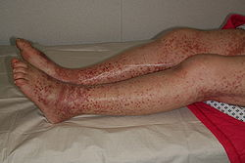
Dengue: An epidemic disease

Slide 2
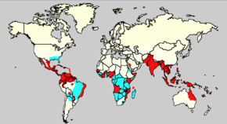
Dengue
Main cause of arthropod-borne
Every year happen 50-100 millon infections and 20 000 persons dead in more than 100 countries of Africa, America and Asia
It is endemic in more than 100 countries
In Cuba, there were 158 deaths for breakbone fever in 1981

Slide 3
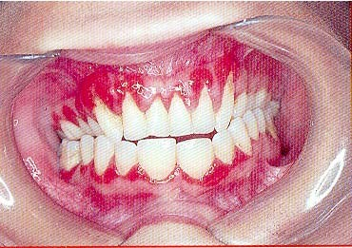
Concept
Feverish intense disease of sudden beginning
Clinical variable ways.
Dengue viruses belong to the genus flavivirus within the Flaviviridae family

Slide 4
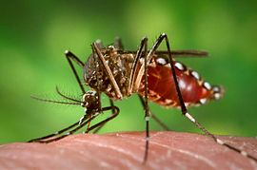
Etiology
There are 4 serotypes
DEN-1
DEN-2
DEN-3
DEN-4
This disease is transmitted for the Aedes Aegypti mosquito
Incubation period: 3-14 days

Slide 5
Breakbone fever
Sign and Symptoms:
Fever
Rash
Breakbone pain
Headache
Vomiting
If severe disease include:Bleeding, abdominal pain and short of breath.
Dengue shock syndrome (DSS)

Slide 6
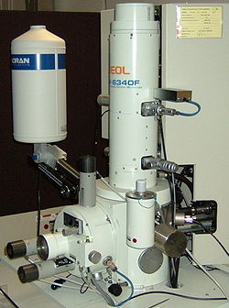
Laboratory diagnosis
Hemogram: leukopenia , Lymphocytosis and Hemoconcentration
Thrombocytopenia
Enzyme-Linked ImmunoSorbent Assay(ELISA)
Polymerase chain reaction(PCR)
Other test: ultrasound

Slide 7
Complications
Pertinacious insomnia
Myelitis
Bronchial pneumonia
Meningoencephalitis
Myocarditis
Hepatitis

Slide 8
Management
Preventive treatment
Specific treatment
Symptomatic treatment: Acetaminophen, Do not use Aspirin, neither steroids and to administrate liquids

Slide 9
Definite Diagnosis
Clinical criterion
Epidemiologic criterion
Serological criterion

Slide 10
Differential Diagnosis
Flu
Exanthematous illnesses
Leptospirosis
Viral hepatitis
Swamp fever
Yellow fever
Acute appendicitis

Slide 11
Conclusions:
Dengue is a global threat and it is endemic or epidemic in almost every country located in the tropics. It is important to know the main signs and symptoms to avoid complications. Prevention is essential to decrease the number of patients with this disease. Laboratory test are very useful to define a prognosis.

