Slide 1
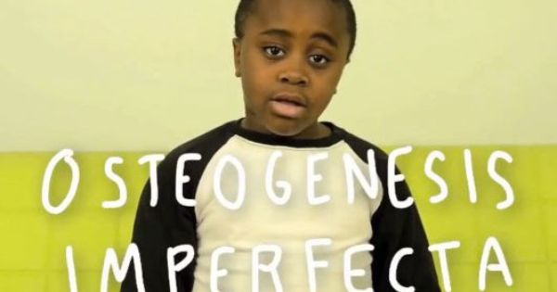
Osteogenesis Imperfecta:
So…If I hold you, I ´ll break you?

Slide 2
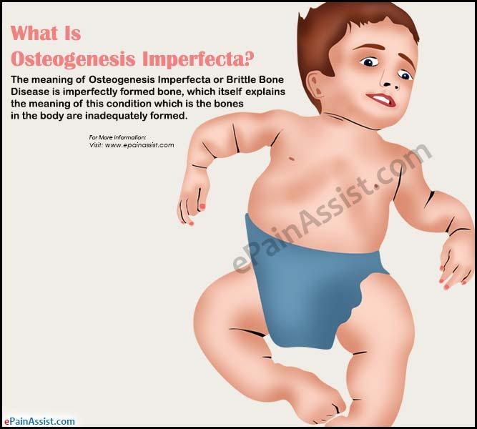
Osteogenesis Imperfecta
Is a group of genetic disorders that mainly affect the bones
Notes:
The term "osteogenesis imperfecta" means imperfect bone formation. People with this condition have bones that break easily, often from mild trauma or with no apparent cause. Multiple fractures are common, and in severe cases, can occur even before birth. Milder cases may involve only a few fractures over a person's lifetime

Slide 3
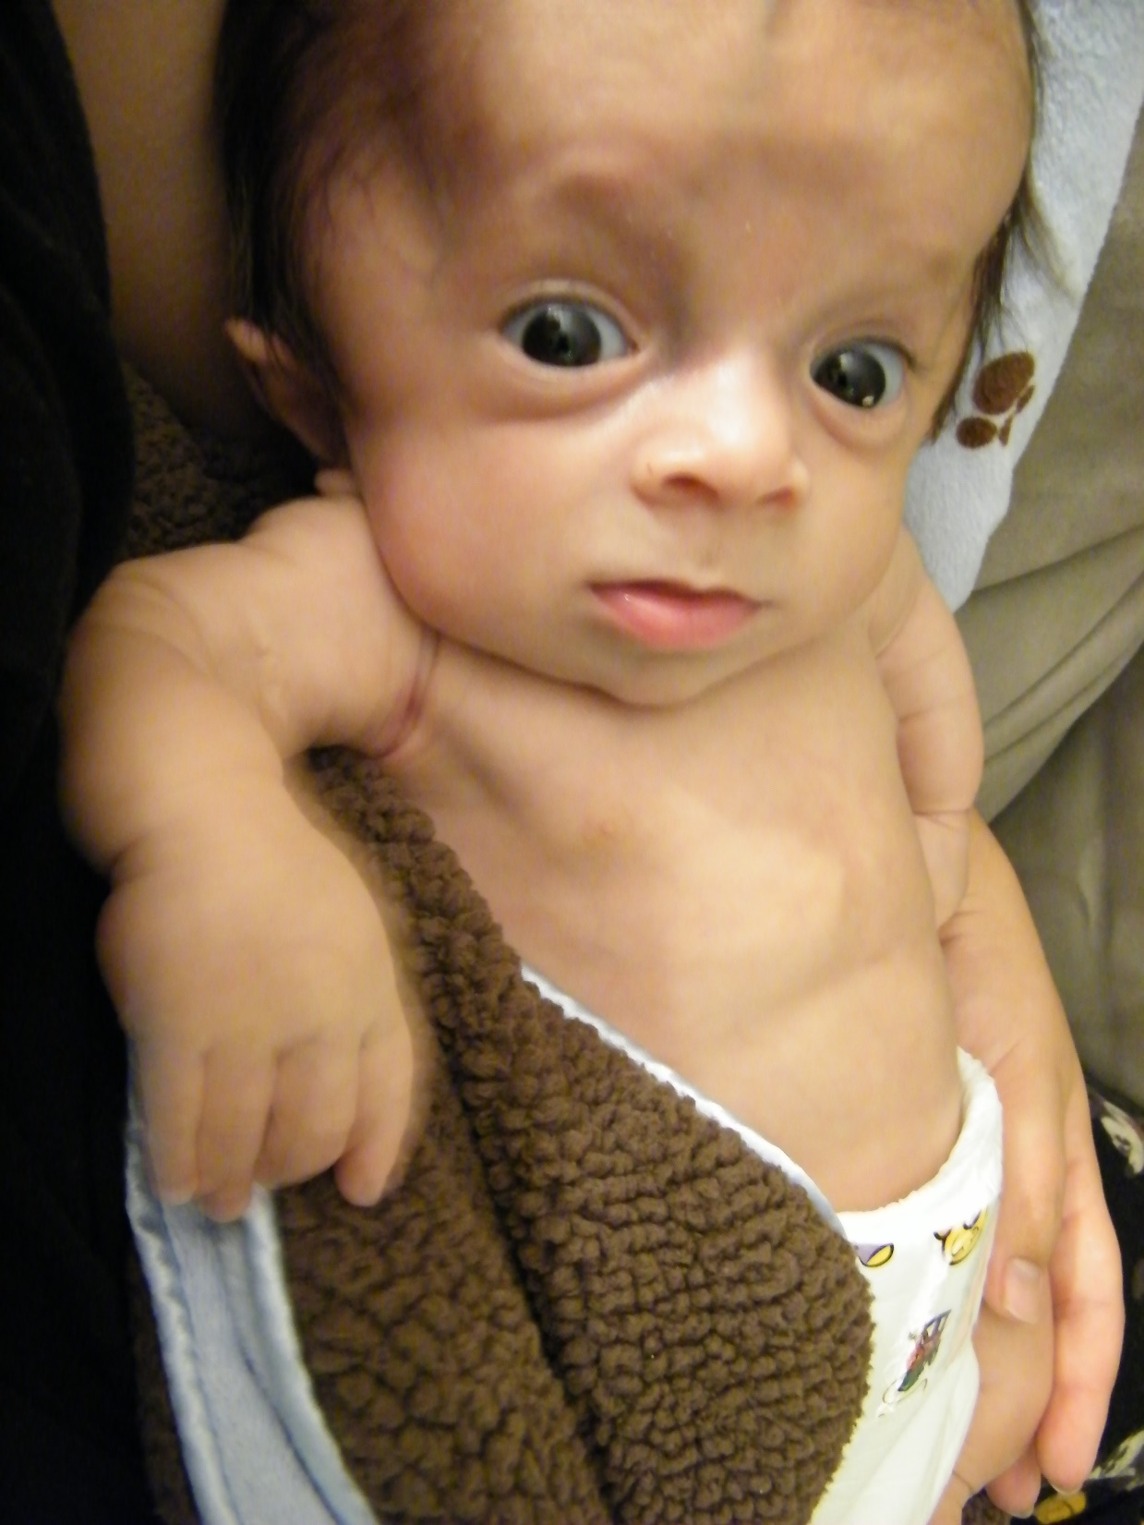
Frecuency
This condition affects an estimated 6 to 7 per 100,000 people worldwide.

Slide 4
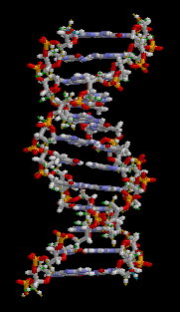
Causes
Mutations in the COL1A1, COL1A2, CRTAP, and P3H1 genes cause osteogenesis imperfecta
Notes:
.
Mutations in the COL1A1 and COL1A2 genes are responsible for more than 90 percent of all cases of osteogenesis imperfecta. These genes provide instructions for making proteins that are used to assemble type I collagen. This type of collagen is the most abundant protein in bone, skin, and other connective tissues that provide structure and strength to the body.

Slide 5
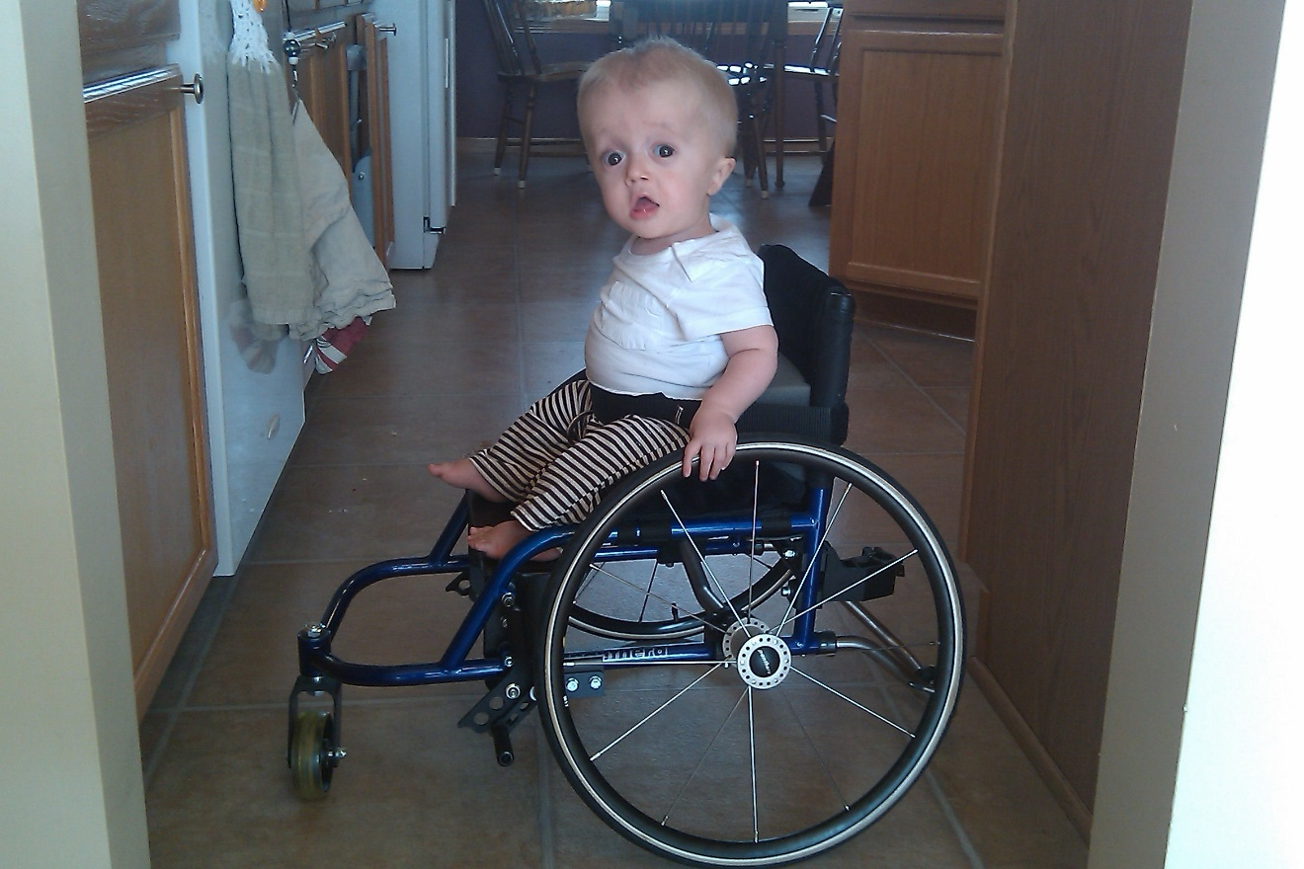
Types
There are at least eight recognized forms of osteogenesis imperfecta,
Notes:
designated type I through type VIII. The types can be distinguished by their signs and symptoms, although their characteristic features overlap. Types I and IV are the most common forms of osteogenesis imperfecta, affecting 4 to 5 per 100,000 people

Slide 6
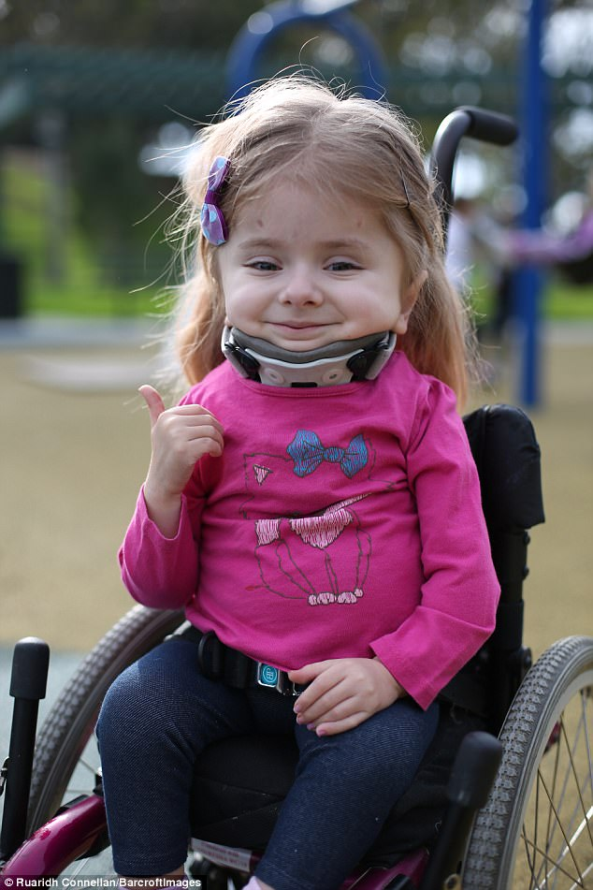
Type I Osteogenesis
Most common
People who have type I disease generally reach normal height and have few obvious skeletal deformities
Typically causes more fractures during childhood than in adulthood.
Hearing loss is pronunced and begins early in childhood

Slide 7
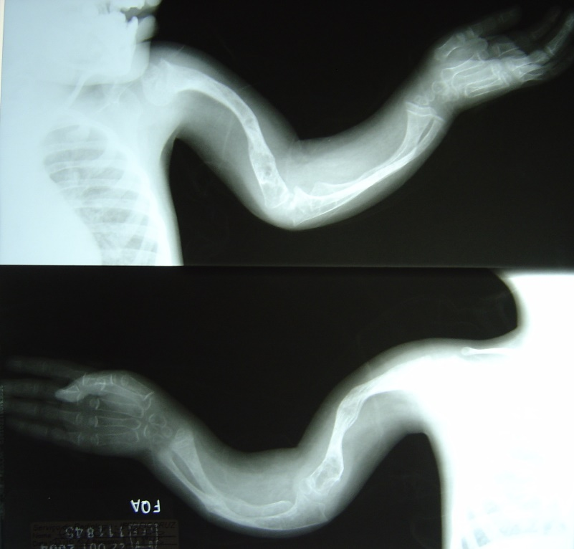
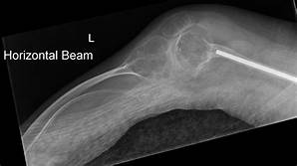
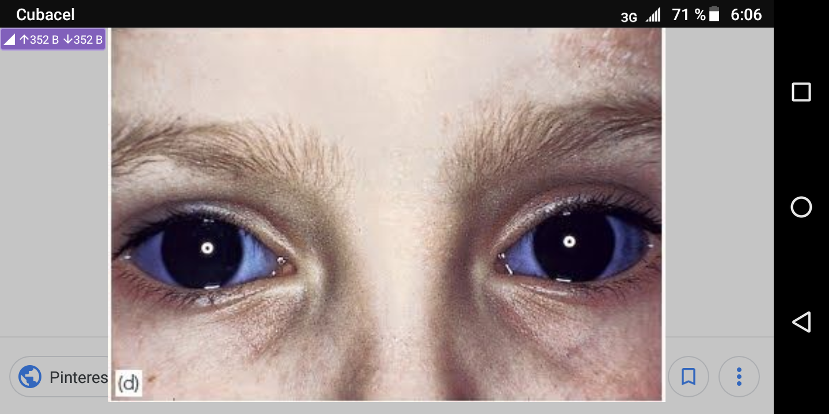
Type II Osteogenesis
Most severe form
Exhibits extreme bone fragility and frequent fractures
Blue sclera may be present

Slide 8
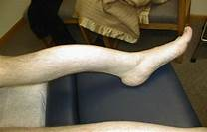
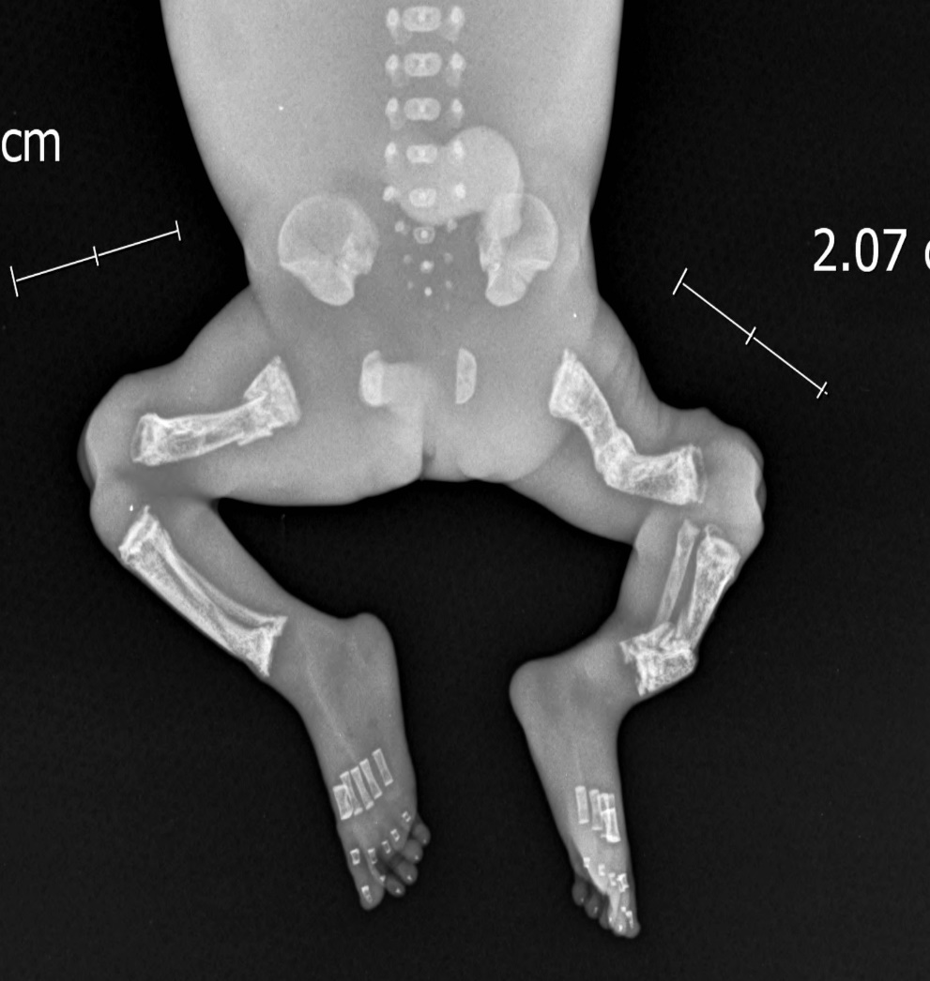
Type III Osteogenesis
Is a severe and progressively deforming type
Affected individuals suffer from multiple fractures that start from the initials years of their life

Slide 9
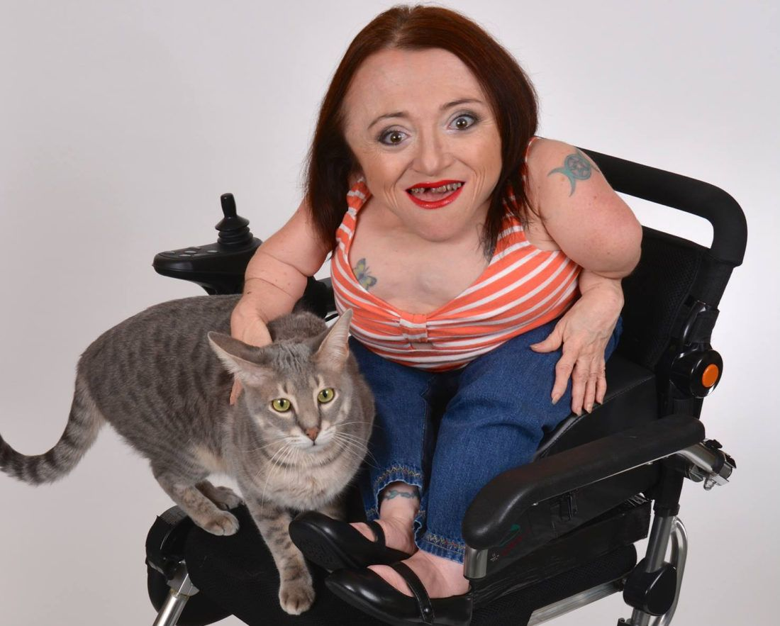
Type IV Osteogenesis
Similar to Type I
Life expectancy is close to normal or completely normal
Sclera-normal

Slide 10
Diagnosis
Clinical
Genetic Tests
X- Ray

Slide 11
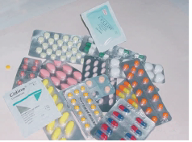
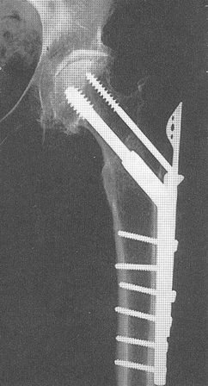
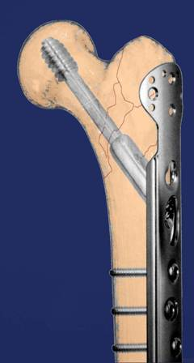
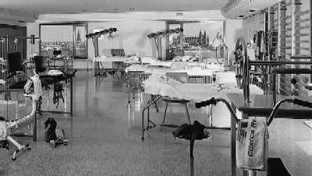
Treatment
Osteogenesis Imperfecta has no cure
An integral tratment of the osteogenesis imperfecta should be susteined fundamentally in 3 pillars:
pharmacollogical,
orthopedic
rehabilitative treatment

Slide 12
Conclusions
Osteogenesis imperfecta (OI) is a group of genetic disorders that mainly affect the bones
There are at least eight recognized forms, designated type I through type VIII.
Types I and IV are the most common forms
Type II is the most severe form

Slide 13
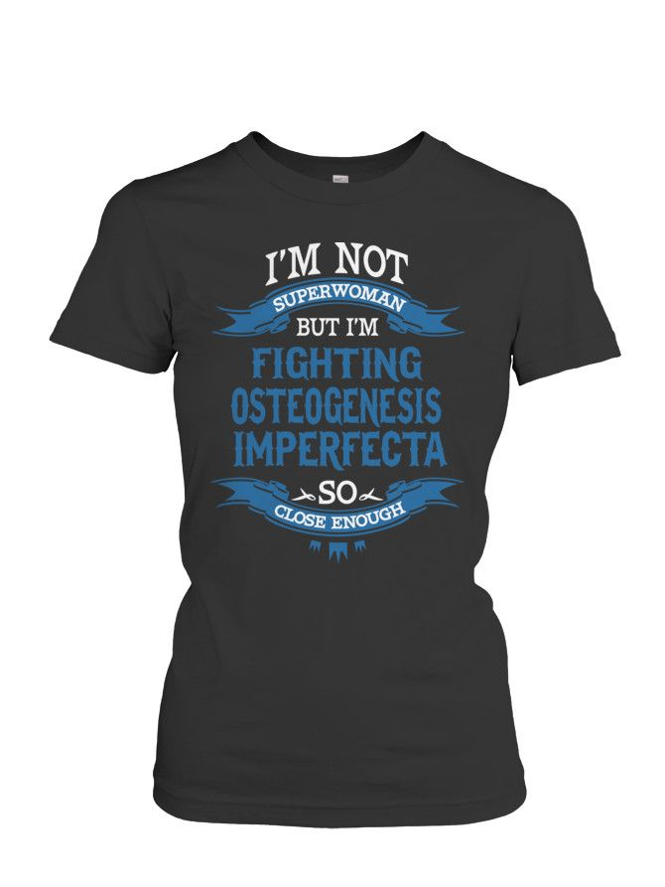
As curious fact….
May 6 is the International Day of Osteogenesis Imperfecta

